Slide 1
Evaluation of the NC-CERA Storm Surge and Wave Visualization Tool by Emergency Managers
Jessica Losego
University of North Carolina - Institute for the Environment
Rick Luettich – Director, UNC IMS & DHS Center of Excellence
Carola Kaiser - Louisiana State University
Brian Blanton - UNC RENCI
Jason Fleming - Seahorse Coastal Consulting

Slide 2
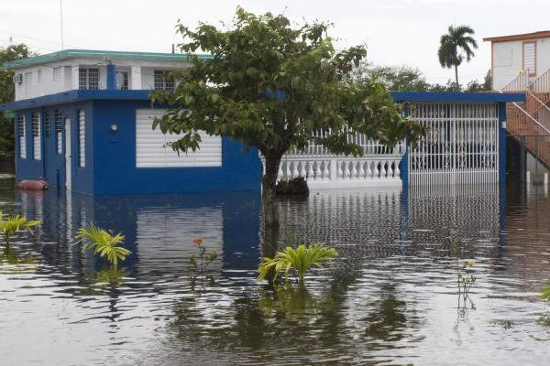
Outline
Coastal Hazards Center background
NC-CERA introduction
EM data collection
Results
Next steps

Slide 3
Coastal Hazards Center
U.S. DHS Center of Excellence, est. 2008
Research lead: UNC
Advance understanding of natural hazards and resilience, transfer knowledge into action
One research area: coastal hazards modeling
NC-CERA development

Slide 4
NC-CERA
NC-Coastal Emergency Risks Assessment
Interactive web visualization of ADCIRC and SWAN Wave model output
Initiated from NHC advisories every 6 hr
Single, deterministic surge and wave forecast for next five days
Complementary tool to NHC products
Notes:
Setup to do multiple member ensembles, but not enough compute resources yet to do it for the East Coast.

Slide 5
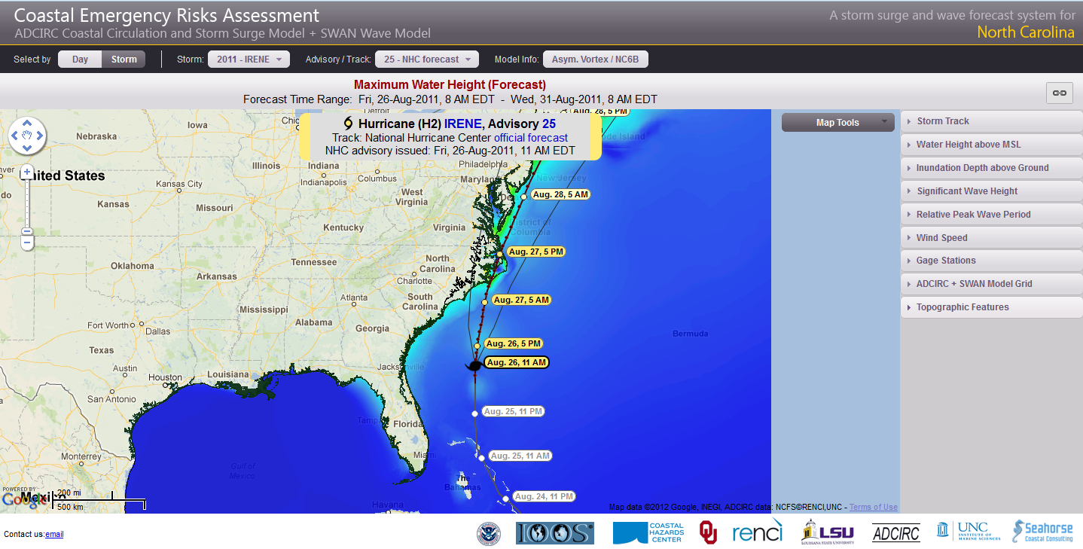
NC-CERA: nc-cera.renci.org Gulf CERA: cera.cct.lsu.edu

Slide 6
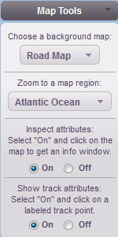
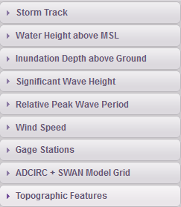
NC-CERA: nc-cera.renci.org Gulf CERA: cera.cct.lsu.edu

Slide 7
NC-CERA: nc-cera.renci.org Gulf CERA: cera.cct.lsu.edu

Slide 8
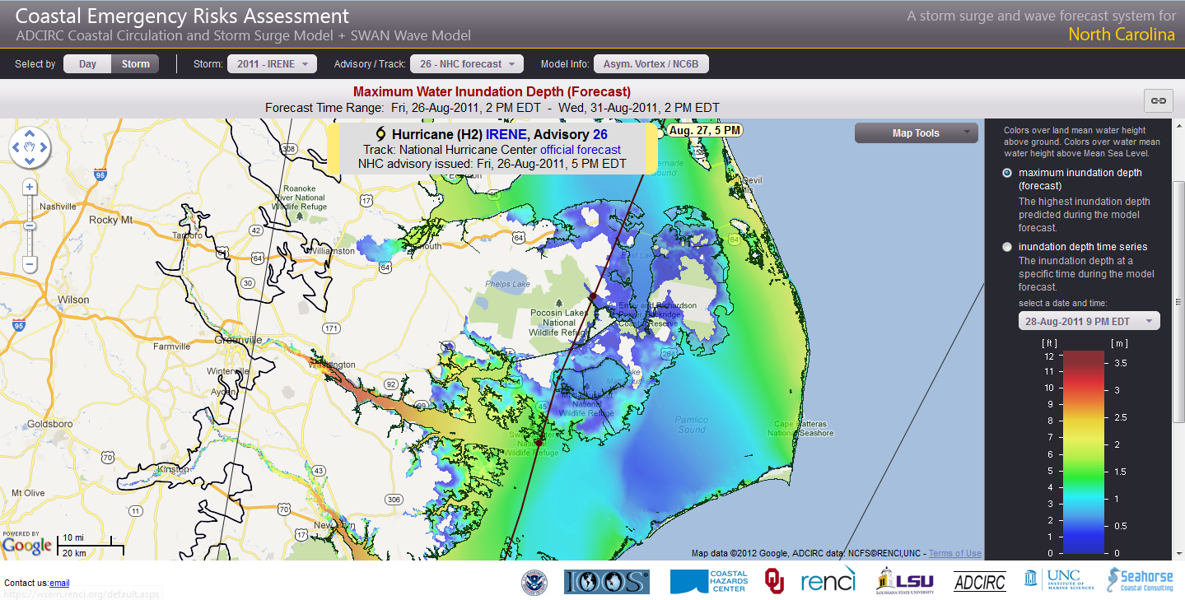
Inundation Depth Above Ground

Slide 9
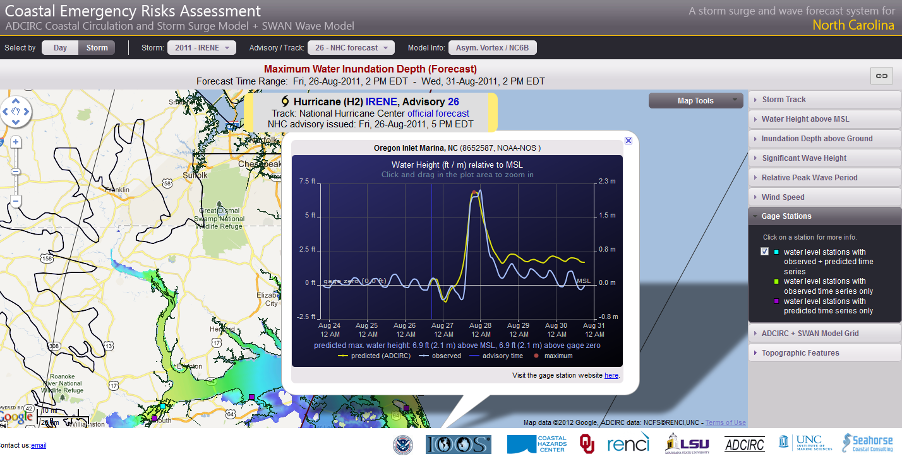
Gage Stations

Slide 10
Evaluation of NC-CERA by NC EMs
Goals of evaluation
Explore NC EM’s perspective on surge information
Demo NC-CERA and gather initial feedback
EM’s main job during an event: explain surge, other forecast information to county officials
EMs need easy-to-understand info that fits into their operational process

Slide 11
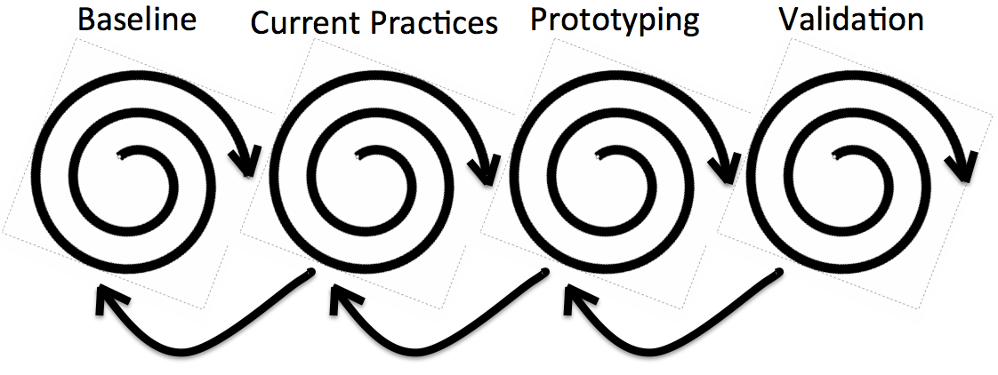
Methodology
Established during Weather for EM Decision Support project (WxEM)
Four step iterative process (Losego et al 2012)
Baseline
Current practices & gaps
Prototype
Validation

Slide 12
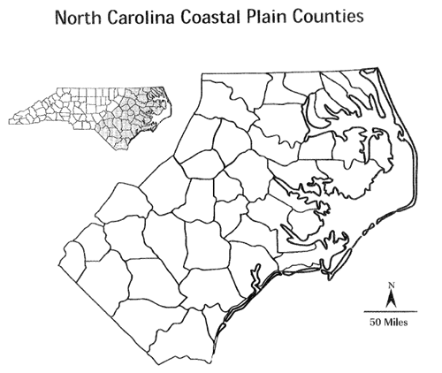
Establish Baseline and Current Practices
Collection methods
Mix of 1-on-1 and group semi-structured interviews
Short survey
What does surge mean to you and your county?
Demo and feedback on NC-CERA
Notes:
13 counties/12 EMs (1 EM is in charge of 2 counties)
EM led discussion, each interview lasted about 2 hr

Slide 13
Preliminary Results: General to Surge
Range of feelings on surge information
Desperate for surge information
“Embarrassed” that he/she isn’t confident in information he/she has and passes along
Low priority for county b/c surge events rare
Fairly comfortable finding information and applying
Need best guess of surge information 72 hr before landfall
Major operational decision point for evacuation: onset time of tropical storm force winds
Notes:
Evacuation decisions need to be made at a time that is earlier than when they receive surge information tailored to the storm at 48 hr before landfall. Evacuation time is based on the onset time of tsf winds. Ferries need to be tied up 12 hr before onset of tsf winds. Making evacuation decisions before storm is even in the Bahamas.

Slide 14
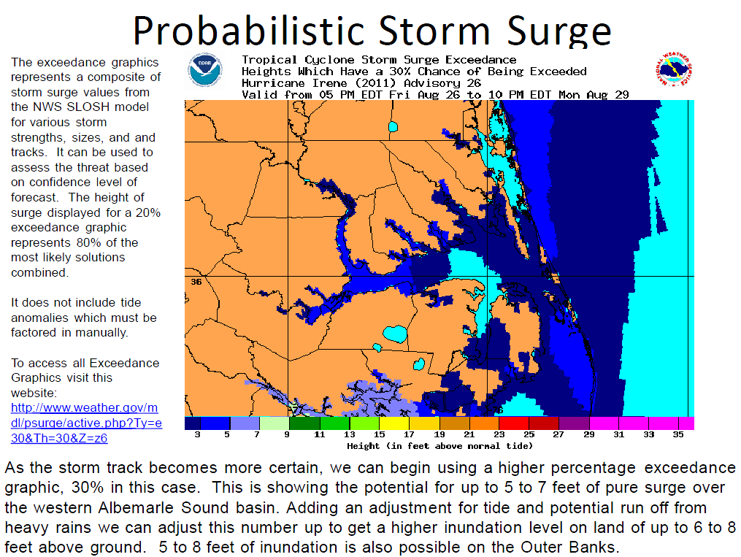
Preliminary Results: General to Surge
Multiple ways EMs get surge information
Briefings from local NWS
HURRTRAK
NHC MOM/MEOW products
NWS Briefing Example
Notes:
MOMs/MEOWs: two EMs say they use these regularly; others range from never using these tools to sometimes. Reasons cited for lack of usage include lack of time, they only recently were trained on how to use them, difficult to find and use, and that they don’t provide information specific to the approaching storm.

Slide 15
Preliminary Results: NC-CERA
Fits operational time scale of needing surge information 72 hr before landfall
Visually appealing
Provides wave information
Rainfall and river flooding info needs to be linked to surge
Notes:
Provides information on the timescale they need (~72 hr before landfall). All categorically understand that the track and intensity of the storm will change as the storm nears, but because they need this information at this time they want a best guess based on the best available information at that time. They feel that this best guess is better than their own.
It is visually appealing. One of the EM’s main jobs during an event is to present information that is easy to understand to their county’s elected officials for their decision making process. The NC-CERA tool is a step in the right direction for communicating this information. Suggested improvements are included in the next section.
Provides wave information. Currently the majority of EMs said that they do not receive, nor know how to find, wave information. Two EMs stated that they use NOAA’s Ocean Prediction Center wave forecasts (e.g., http://www.opc.ncep.noaa.gov/shtml/A_24hrwind_wave.gif) to interpolate how waves may affect their county.
EMs want rainfall information linked to surge information so they can determine “river inundation” in their county. They don’t have access to any tools that give them this information, and it is the biggest and most important bit of information that they are missing to really understand the impact to their county.
Note: River discharge is included in NCFS for the Tar and the Neuse and is used as a boundary forcing term.
Note: While a way to connect rivers and surge is in development, the addition of rainfall observations to the NC-CERA display would help EMs immensely. This would allow them to see how much rain has fallen upstream from them and in their own county so that they can estimate impacts from rainfall. They do not have this information now. More details in next section.

Slide 16
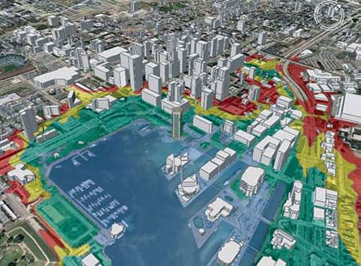
Preliminary Results: NC-CERA
Overlay surge info with infrastructure layers
Mixed on inundation above MSL vs. ground level
Feel that elected officials and public will be confused either way
Example: U.S. Army Corps of Engineers, Baltimore District.

Slide 17
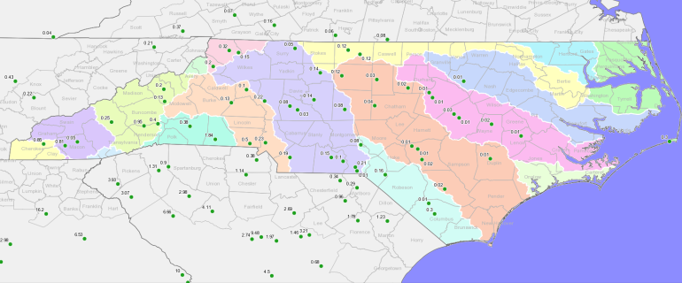
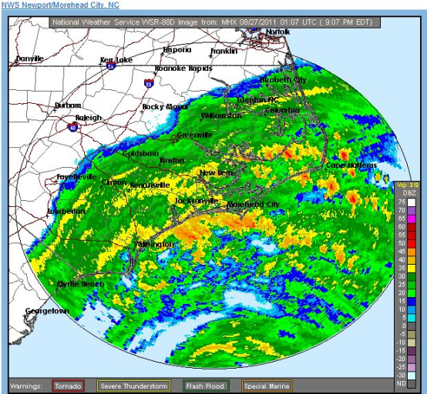
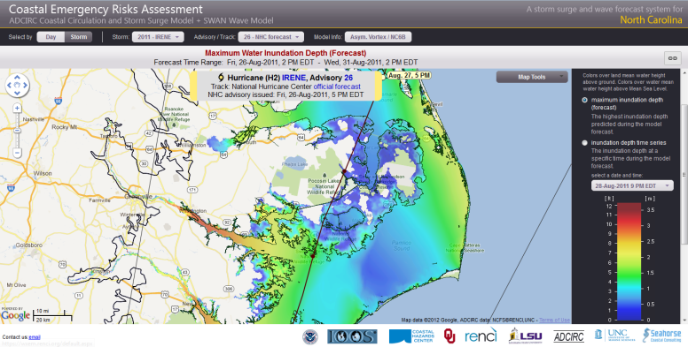
Proposed Modifications to NC-CERA
Observed rainfall data layer
Allows EM to get sense of rainfall
Most EMs do not know how to get this info
NC State Climate Office Obs Feed
NWS Radar Rainfall Estimates
Notes:
This is a fix until river/surge models are linked. At least gives EM the rainfall information they have trouble getting so that they can work out for themselves the impacts on their county.

Slide 18
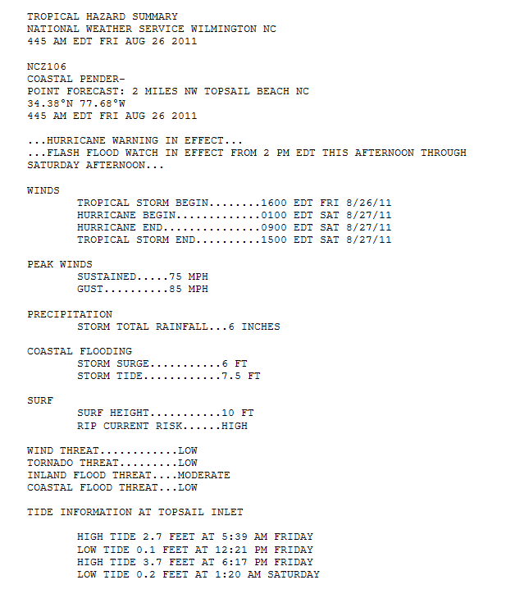
Proposed Modifications to NC-CERA
Ability to create a one page text summary of important forecast parameters
NWS Wilmington/WxEM prototype
Notes:
Could be done for both NWS data and ADCIRC data.

Slide 19
Proposed Modifications to NC-CERA
Ability to create a one page text summary of important forecast parameters
NWS Wilmington/WxEM prototype
WINDS
TROPICAL STORM FORCE BEGIN…..1400 EDT FRI 8/24/11
TROPICAL STORM FORCE END……..1500 EDT SAT 8/27/11
HURRICANE BEGIN…………………...0100 EDT SAT 8/27/11
HURRICANE END……………………...0900 EDT SAT 8/27/11
Notes:
Could be done for both NWS data and ADCIRC data.

Slide 20
Proposed Modifications to NC-CERA
Ability to create a one page text summary of important forecast parameters
NWS Wilmington/WxEM prototype
COASTAL FLOODING
STORM SURGE…………..6 FT
STORM TIDE…………….7.5 FT
Notes:
Could be done for both NWS data and ADCIRC data.

Slide 21
Proposed Modifications to NC-CERA
Ability to create a one page text summary of important forecast parameters
NWS Wilmington/WxEM prototype
PEAK WINDS
STORM TOTAL RAINFALL
SURF
WIND,TORNADO,INLAND FLOOD, AND COASTAL FLOOD THREAT
TIDE INFO
Notes:
Could be done for both NWS data and ADCIRC data.

Slide 22
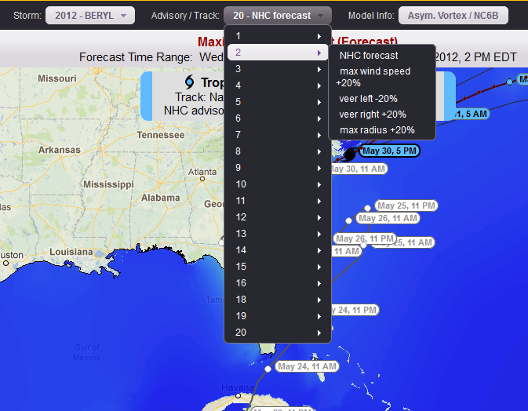
Modification to NC-CERA
Variations
Max wind speed
Veer left and right
Maximum radius
EMs have a sense of track/intensity errors
Available for 2012 season
Notes:
It was in the works, but wasn’t yet available when interviews were conducted. Several EMs asked unprompted if a couple of variations could be shown.
EMs like the proposed idea of providing surge data from different tracks (official forecast from the center of cone, left of center, and right of center) and forward speeds. Before even discussing this idea during the interviews, several EMs stated that they’d like to have the ability to shift the track and intensity of the storm slightly (~50 miles distance) because they have a sense of what direction the track normally errors on. Although intensity may not be feasible at this point, EMs thought having three tracks would be very useful because it allows them to see how impacts may change with a shift in track.

Slide 23
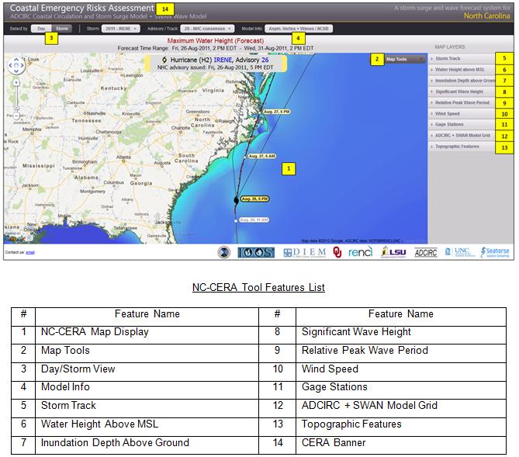
Training
Training available
Goal: make EMs comfortable using NC-CERA
Instruction guide created to describe features
Online or in person training after modifications

Slide 24
Next Steps
Make proposed modifications for next season
Visit with EMs again to demo, train
Mobile version development
Find ways to better integrate NC-CERA data into operational process

Slide 25
Jessica Losego
UNC Institute for the Environment
jlosego@unc.edu
Losego, J.L., K.J. Galluppi, B.E. Montz, C.F. Smith, and S. Schotz, Weather for Emergency Management: Implications for NWS Tropical Weather Products and Services, 92nd American Meteorological Society Annual Meeting, January 2012, New Orleans, LA.
This material is based upon work supported by the Coastal Hazards Center of Excellence, a US Department of Homeland Security Science and Technology Center of Excellence under Award Number: 2008-ST-061-ND 0001.

